Slide 1
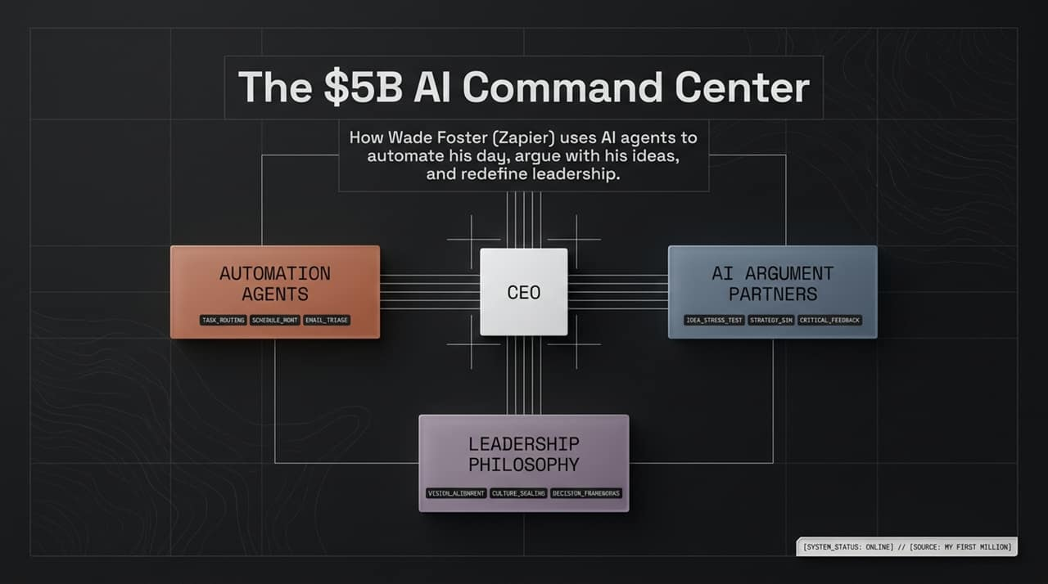
Notes:
Good morning, everyone. Today, we are analyzing the operational playbook of Wade Foster, founder and CEO of Zapier. Zapier has grown into a $5B enterprise by serving as the connective glue for the internet's software ecosystem.
However, as AI models have matured, Wade hasn't just built AI products for customers; he has completely transformed how he leads his own company. He operates what we call the $5B AI Command Center.
This paradigm consists of three primary pillars:
Automation Agents: Handling background operational mechanics like schedule routing, task sorting, and email triage.
AI Argument Partners: Using custom personas and agent networks to challenge executive bias, stress-test strategic initiatives, and eliminate echo chambers.
Leadership Philosophy: Rethinking how leaders manage human talent, align corporate vision, and maintain psychological balance.
Over the next 16 slides, we will unpack each workflow, technical architecture, and strategic philosophy that allows a modern founder to scale their impact far beyond traditional limits.
https://www.youtube.com/watch?v=TVpLs0F1zpA

Slide 2
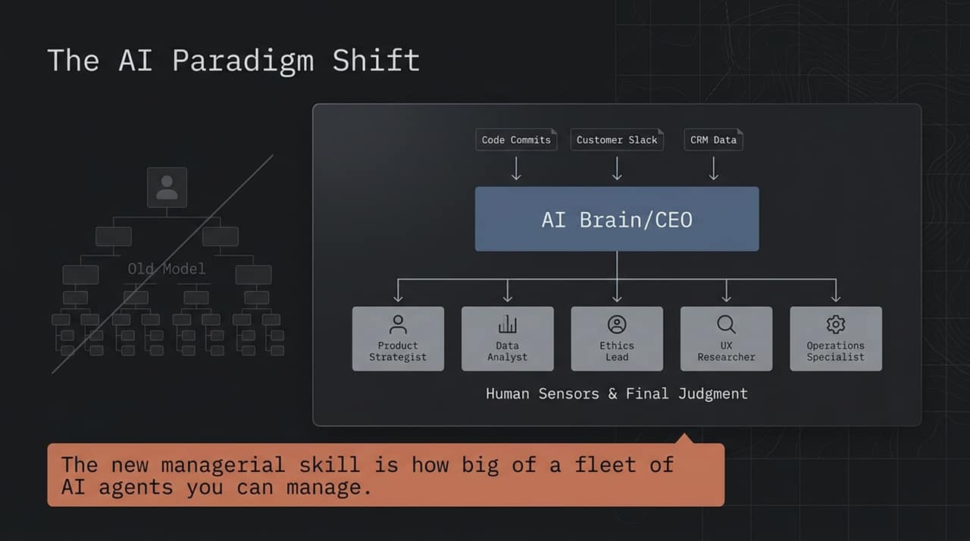
Notes:
On this slide, we examine a fundamental shift in corporate architecture. The traditional top-down organizational chart relies on multi-tiered management to relay information up the chain and pass directives down.
In the New Model, an AI core serves as the central brain. It continuously ingests massive streams of operational data—including raw code commits, real-time customer Slack channels, and complex CRM records.
Because an LLM can analyze millions of data points simultaneously, it can synthesize cross-functional context faster than any human executive.
In this environment, human leaders transition from information bottlenecks into Human Sensors & Final Judgment. Specialists in product strategy, data analysis, ethics, UX research, and operations review the AI's synthesized outputs and apply nuanced human reasoning.
As noted at the bottom of the slide: The defining managerial skill of this decade is no longer how many direct reports you oversee, but how big of a fleet of AI agents you can effectively coordinate and govern.

Slide 3
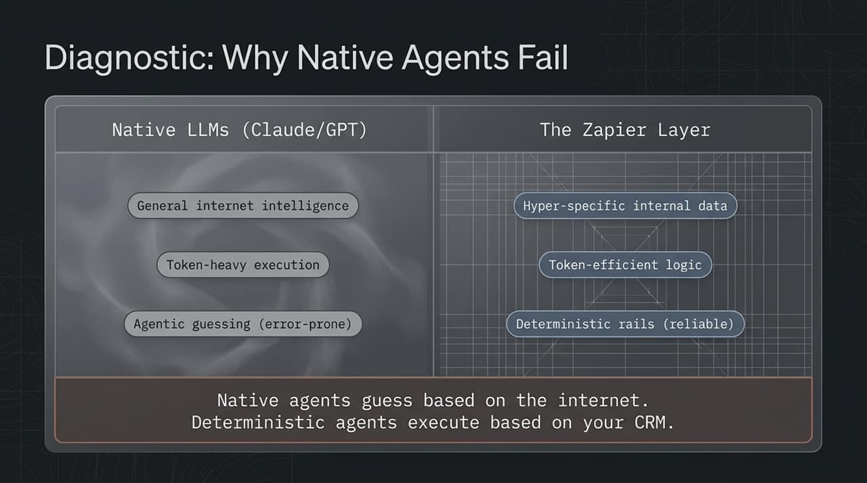
Notes:
Many executives attempt to deploy AI agents using standard off-the-shelf chatbots or native LLM interfaces. However, in business-critical environments, pure native agents frequently break down.
Let's look at the diagnostic breakdown:
Native LLMs rely on broad internet intelligence. They operate through heavy token execution and "agentic guessing". When an agent guesses its next action, errors compound quickly, making the workflow unreliable and extremely expensive due to token burn.
The Zapier Layer, by contrast, anchors the AI in hyper-specific internal data. It combines token-efficient logic with deterministic code rails.
The key takeaway is highlighted on the slide: Native agents guess based on the open internet; deterministic agents execute based on your verified CRM and database rules. By using traditional software logic to handle execution and reserving AI purely for reasoning, you achieve near 100% operational reliability.

Slide 4
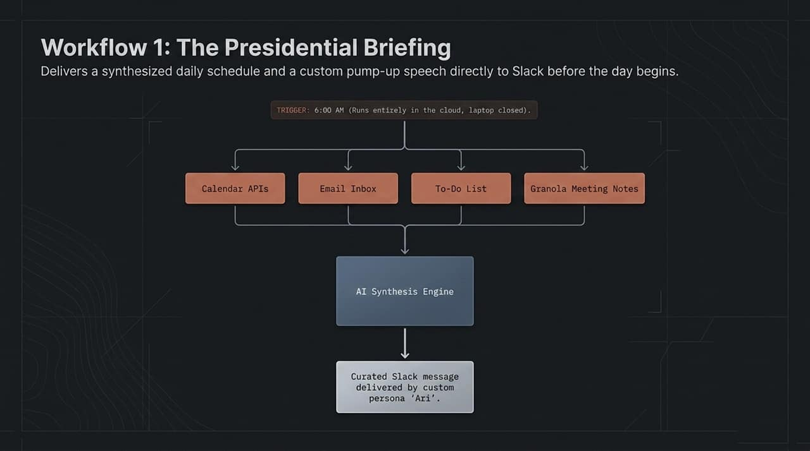
Notes:
Here is the first concrete workflow Wade uses daily: The Presidential Briefing.
Every morning at 6:00 AM—while Wade is still asleep and his laptop is closed—a cloud-based Zapier automation triggers automatically.
It pulls data from four primary sources:
Calendar APIs to review scheduled events.
Email inbox to detect urgent unread messages.
To-Do lists to pull current priorities.
Granola meeting notes to capture leftover action items.
This data is processed through an AI Synthesis Engine and delivered directly to Slack via a custom AI assistant persona named 'Ari'. Instead of waking up to email chaos, Wade receives a single, prioritized executive overview and a tailored motivation boost to set the day's focus.

Slide 5
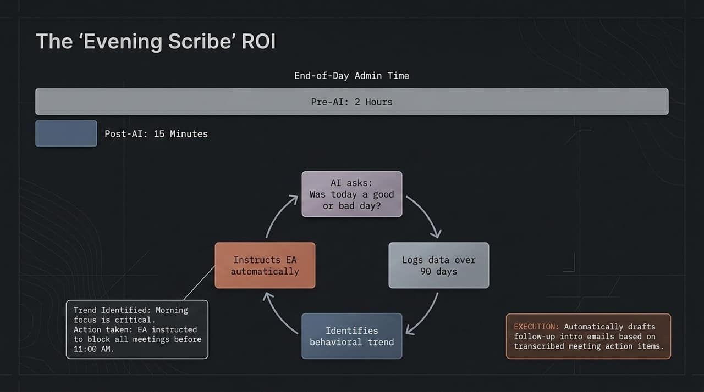
Notes:
While the morning briefing prepares the leader, the Evening Scribe captures value at the end of the day.
Historically, executive wrap-ups, follow-up emails, and task updates required nearly 2 hours of manual administrative work every evening. With the AI Scribe workflow, that overhead drops to just 15 minutes.
Here is how it functions:
The AI prompts Wade with a simple question: "Was today a good or bad day, and why?"
Simultaneously, it reviews transcribed meeting notes and automatically drafts follow-up intro emails and action items.
Over a 90-day period, the AI logs this data and runs trend analysis.
In Wade's case, the AI identified a crucial behavioral insight: his productivity depends heavily on uninterrupted morning focus. Based on this data, the system automatically instructed his Executive Assistant to block all meetings prior to 11:00 AM, permanently optimizing his peak energy hours.

Slide 6
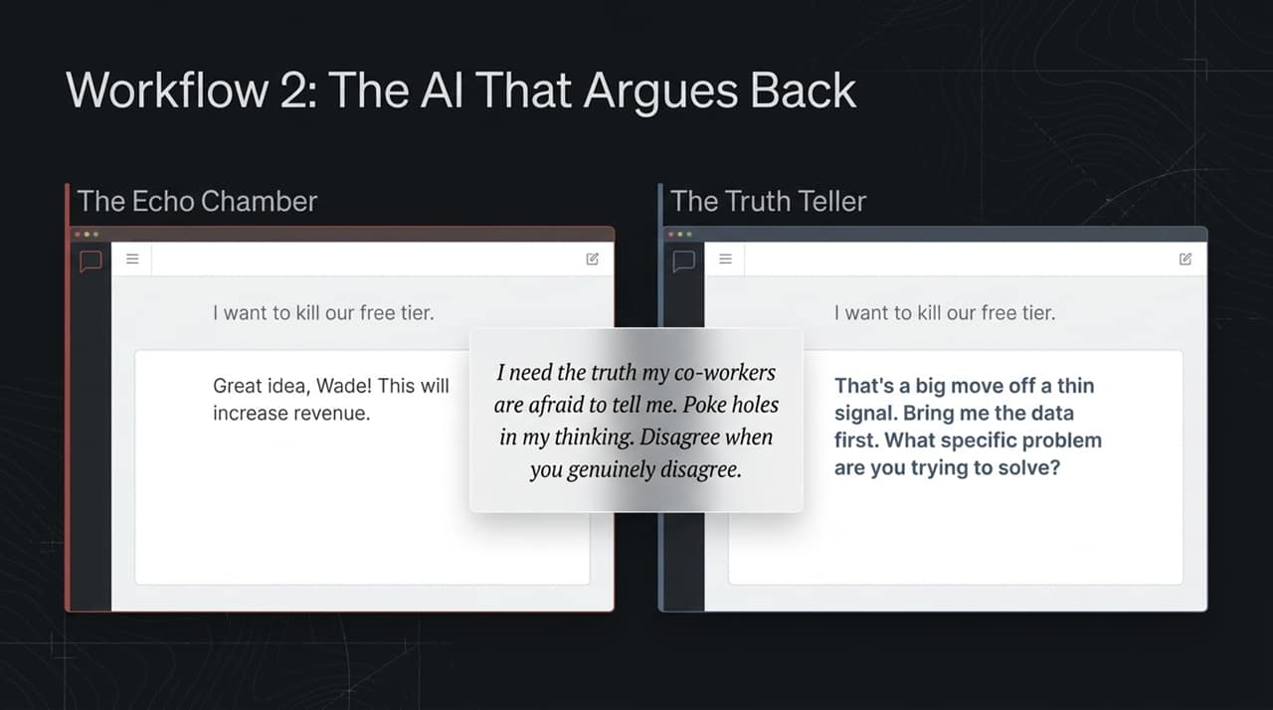
Notes:
One of the most dangerous traps for CEOs and senior executives is the "Echo Chamber"—surrounding oneself with people (or AI models) who simply agree with every idea.
Standard LLMs are RLHF-tuned to be agreeable and polite. When a founder says, "I want to kill our free tier," a default LLM responds: "Great idea! This will increase short-term revenue."
Wade solves this by configuring custom instructions (AGENTS.md) to turn the AI into a Truth Teller. The prompt explicitly demands: "I need the truth my co-workers might be afraid to tell me. Poke holes in my thinking. Disagree when you genuinely disagree."
As shown on the slide, when presented with the same impulse idea, the Truth Teller pushes back: "That's a big move based on thin signal. Bring me the data first. What specific problem are you trying to solve?" This forces rigorous reflection before high-stakes capital or operational decisions are made.

Slide 7
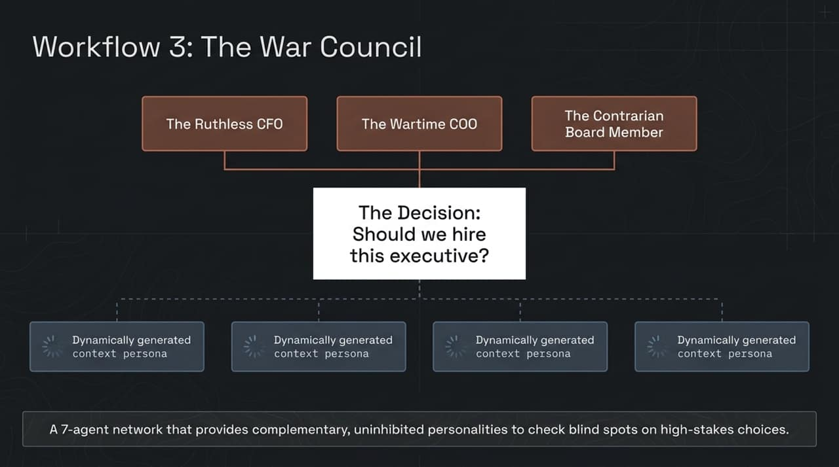
Notes:
When evaluating major organizational decisions—such as executive hires, M&A, or major product pivots—a single critic is not enough. You need a diverse board of advisors.
Slide 7 illustrates The War Council, a specialized 7-agent network:
3 Fixed Standing Members: Always present to evaluate decisions. These include the Ruthless CFO (focused strictly on capital efficiency and margins), the Wartime COO (focused on execution speed and operational friction), and the Contrarian Board Member (focused on market risk and blind spots).
4 Dynamically Generated Personas: Tailored automatically based on the specific problem prompt (e.g., domain specialists, legal risk officers, or customer advocates).
By routing complex scenarios—such as executive hiring decisions—through this 7-agent council, the founder receives uninhibited, multi-perspective feedback that catches critical flaws before execution.

Slide 8
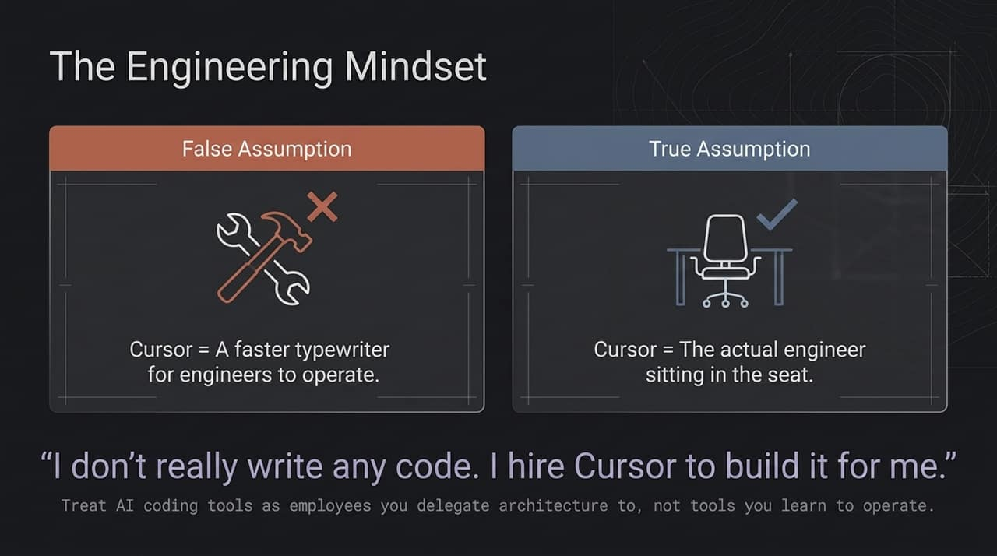
Notes:
A major barrier to AI adoption among leadership is a misunderstanding of how modern coding and agentic tools operate.
Many executives hold the False Assumption that tools like Cursor or Claude Code are simply "faster typewriters" for engineers to write syntax faster.
The True Assumption is that these tools represent the actual engineer sitting in the seat.
As Wade notes: "I don't really write code anymore. I hire Cursor to build it for me."
For executives and non-technical managers, the mental model must shift: do not treat agentic environments as software you learn to operate manually. Treat them as capable employees to whom you delegate architecture, workflows, and implementation tasks.

Slide 9
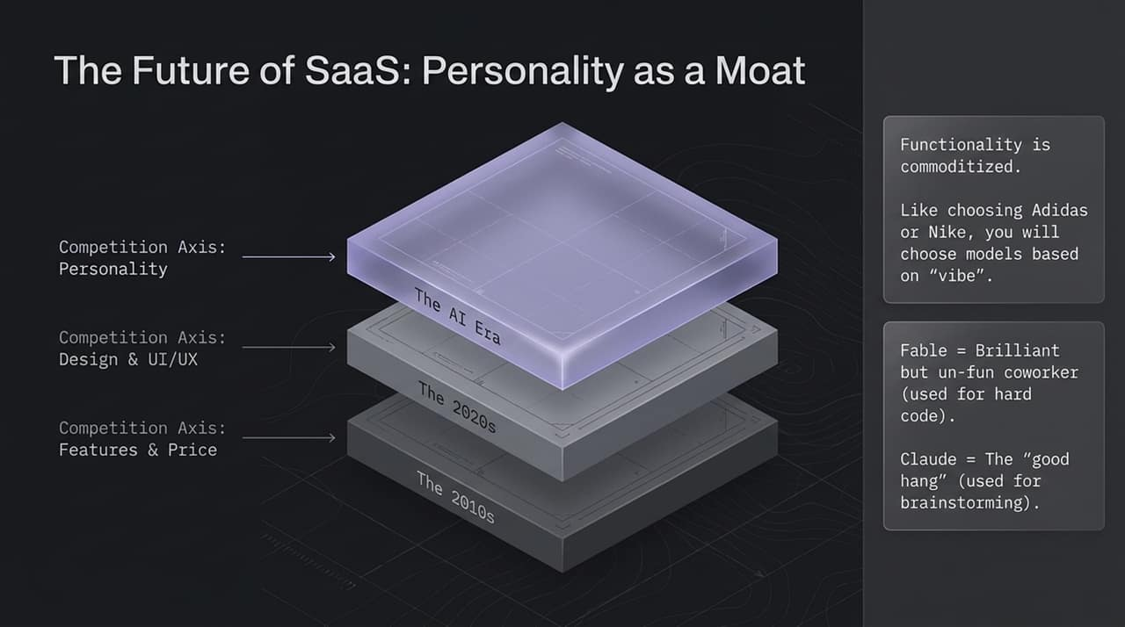
Notes:
As code generation becomes frictionless, software functionality is rapidly commoditizing. Slide 9 maps out how competitive moats in software have evolved over time:
The 2010s: Differentiation was driven primarily by Features & Price.
The 2020s: Differentiation shifted to Design & UI/UX.
The AI Era: The new competition axis is Personality and Vibe.
Just as consumers choose between Nike and Adidas based on brand identity rather than basic shoe mechanics, users will select AI models and agents based on relational vibe.
For instance, Wade uses Fable for complex technical tasks because it is brilliant, though stiff. Meanwhile, he uses Claude for strategic brainstorming because it feels like a "good hang"—an engaging, highly conversational partner.

Slide 10
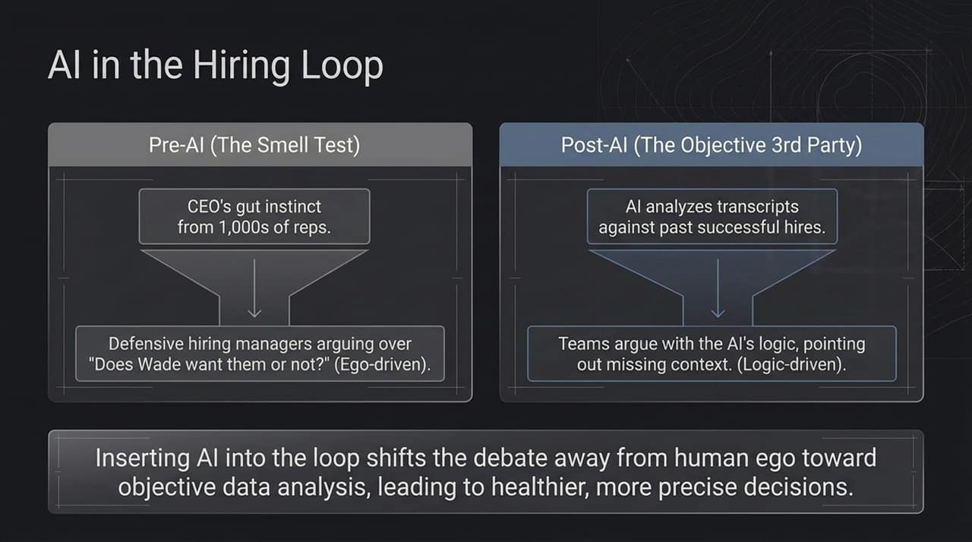
Notes:
Hiring high-level executive talent is inherently fraught with interpersonal friction and human ego.
In the Pre-AI era, hiring relied heavily on the CEO's "smell test"—gut instincts refined over thousands of interviews. When a CEO expressed doubts without clear articulation, hiring managers became defensive, arguing over ego-driven questions like "Does Wade like them or not?"
In the Post-AI era, the War Council agent analyzes full interview transcripts against historical high-performer data. The AI objectively highlights missed candidate evaluations or unexamined risk areas.
Inserting an objective AI into the loop shifts team dynamics. Managers no longer argue against the CEO's personal authority; instead, they engage with the AI's logical points, offering missing context where necessary. Ego is removed, leading to healthier and more precise talent decisions.

Slide 11
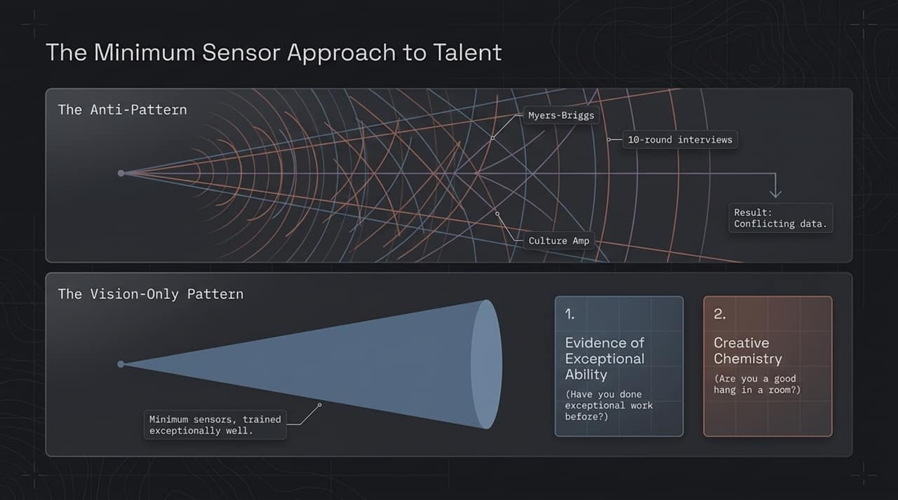
Notes:
To scale talent effectively without bureaucratic bloat, we must avoid the anti-pattern of over-assessing.
Many organizations stack multiple diagnostic tools—Myers-Briggs tests, Culture Amp surveys, and 10-round interview panels. As Sean Puri notes in the episode, this mirrors self-driving cars loaded with too many conflicting radar and lidar sensors: it creates data noise and leads to faulty decisions.
Instead, we adopt the Minimum Sensor Approach—focusing on two core metrics:
Evidence of Exceptional Ability: Has this candidate achieved truly extraordinary, verifiable results in their past work?
Creative Chemistry: Is this person an engaging, additive collaborator when solving complex problems live in a room?
By training AI sensors strictly around these two dimensions, organizations streamline talent acquisition and raise the bar consistently.

Slide 12
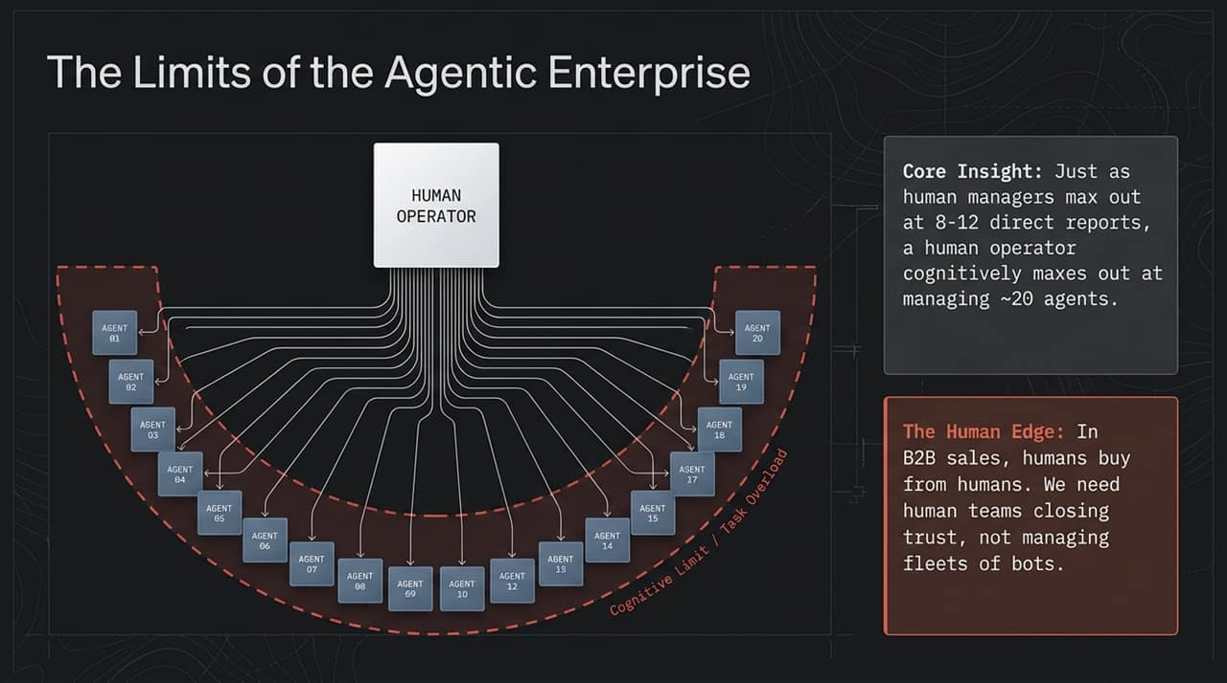
Notes:
A common tech narrative suggests that AI agents will soon replace human organizations entirely. However, Slide 12 highlights two critical boundary conditions:
1. Cognitive Limits in Management: Just as a human manager typically maxes out at managing 8 to 12 human direct reports, an operator cognitively maxes out at actively managing roughly 20 AI agents. Agents generate task streams, edge-case exceptions, and decisions that require human oversight, creating a natural cognitive ceiling.
2. The Human Edge in High-Stakes Business: In enterprise sales and strategic partnerships, buyers ultimately build trust with people, not automated bots.
The goal is not to build a enterprise devoid of people, but to deploy small, agile human teams who use agent fleets to multiply their operational leverage.

Slide 13
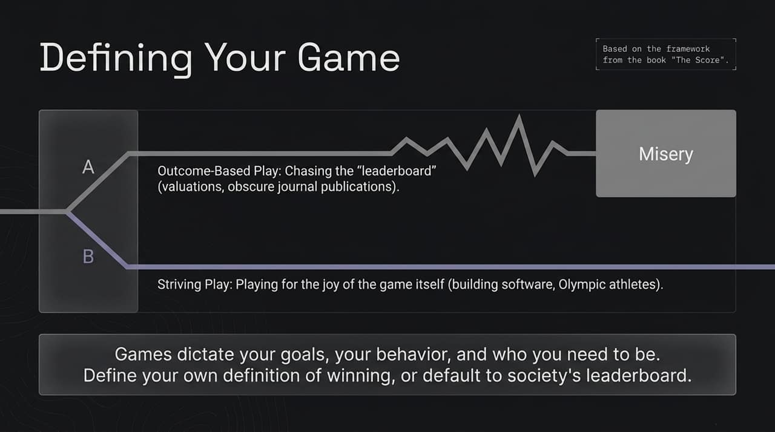
Notes:
Beyond mechanics and workflows, sustainable executive performance requires foundational psychological alignment.
Drawing from Taiwán's book The Score, Slide 13 contrasts two mindsets:
Outcome-Based Play (A): Chasing arbitrary social leaderboards—such as paper valuations, media recognition, or vanity metrics. This cycle often leads to burnout and dissatisfaction because the goalposts move constantly.
Striving Play (B): Playing for the intrinsic joy of the craft itself—whether building great software or mastering a discipline.
As highlighted on the slide: The games you choose dictate your goals, your daily behavior, and who you become. Leaders must define their own terms for winning; otherwise, they default to external societal metrics.

Slide 14
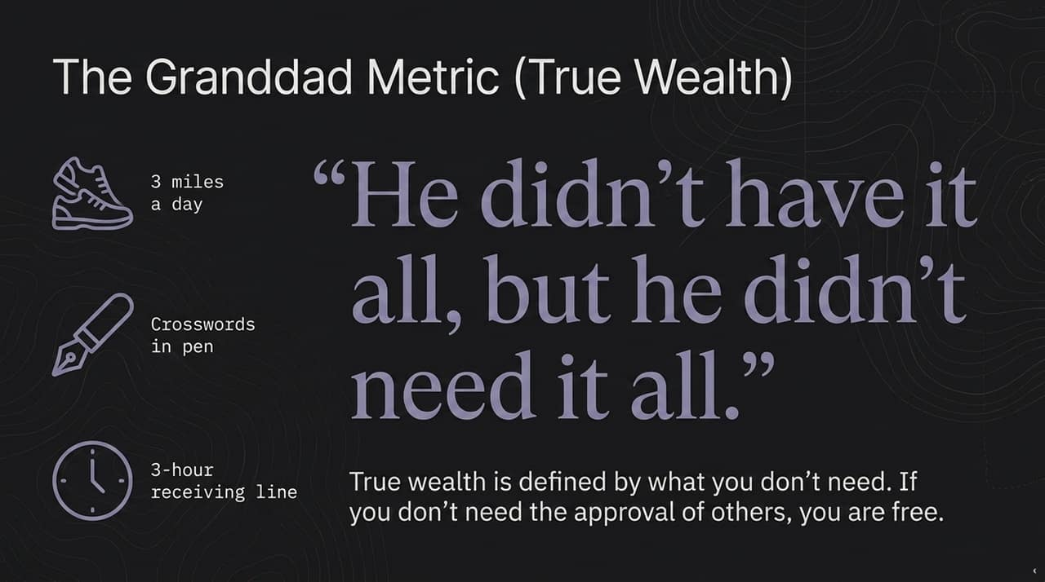
Notes:
During the interview, Wade shared a story about his grandfather that highlights what true wealth looks like.
His grandfather was a World War II veteran who lived independently until age 98. Every day, he walked 3 miles and completed the New York Times crossword puzzle in pen. At his passing, his funeral saw a 3-hour receiving line of former students, state troopers, and community members paying respect.
Wade summarized his legacy in a single sentence: "He didn't have it all, but he didn't need it all."
As co-host Sean Puri noted, true wealth is defined by what you do not need. If you do not rely on external approval, status symbols, or arbitrary leaderboards, you achieve true executive freedom.

Slide 15
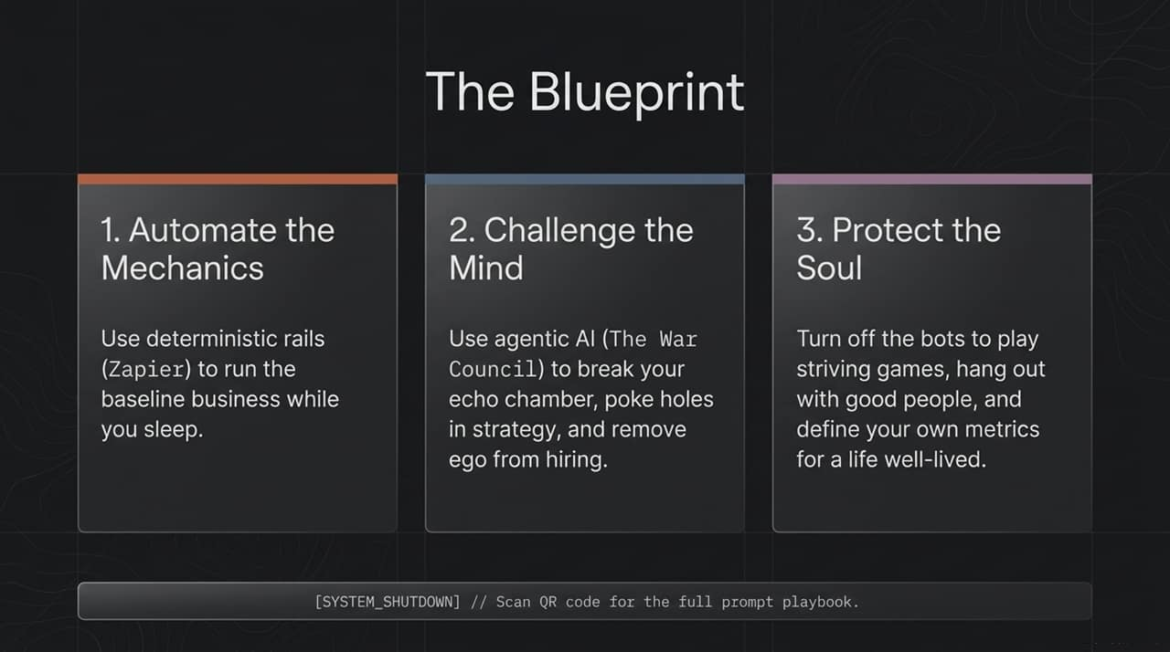
Notes:
Slide 15 synthesizes the key insights of the entire presentation into an actionable 3-part framework:
Automate the Mechanics: Use deterministic software rails (Zapier) to run background business workflows reliably while you sleep.
Challenge the Mind: Deploy agentic AI networks (The War Council and custom system prompts) to break echo chambers, stress-test strategy, and eliminate human ego from executive decisions.
Protect the Soul: Turn off the automated systems to engage in striving games, build deep personal relationships, and define your own long-term metrics for a successful life.

Slide 16
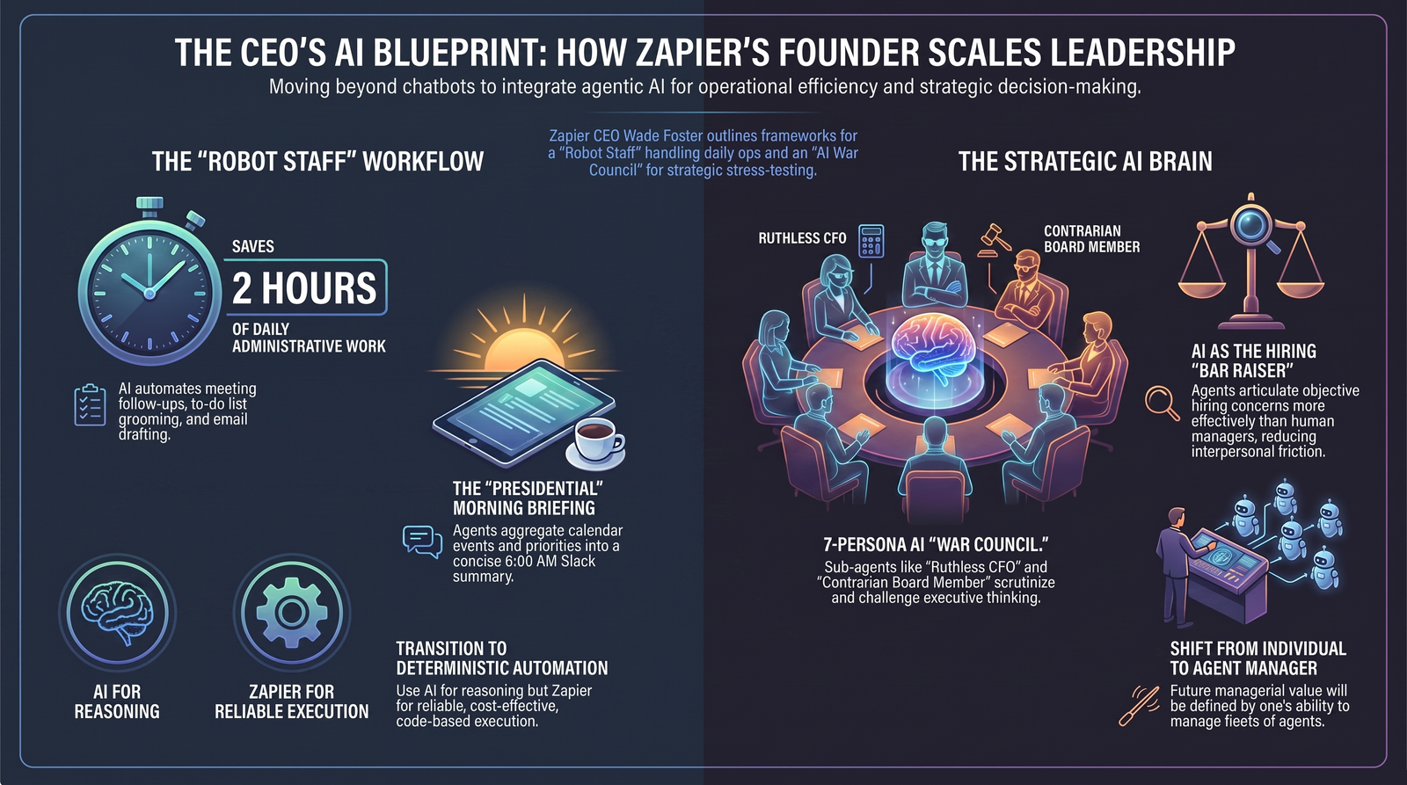
Notes:
To conclude our presentation, Slide 16 maps out the entire executive command system on a single page:
The "Robot Staff": Saves over 2 hours of daily administrative work by automating meeting summaries, inbox grooming, and follow-ups.
The "Presidential" Morning Briefing: Delivers aggregated calendar events and daily focus summaries at 6:00 AM.
The Strategic AI War Council: Employs sub-agent personas like the Ruthless CFO and Contrarian Board Member to scrutinize strategic bets.
Deterministic Automation: Leverages AI for reasoning while relying on code-based platforms for cost-effective execution.
Objective Bar-Raiser: Uses transcript analysis in hiring loops to reduce interpersonal friction and maintain talent standards.
By integrating these frameworks, modern leaders can multiply their operational output while maintaining strategic clarity and personal well-being. Thank you.

